Slide 1
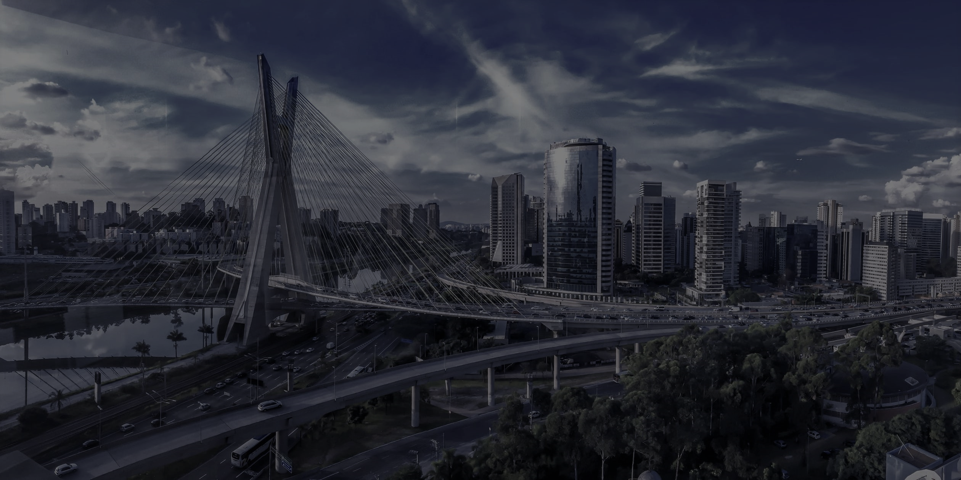

IDENTRIX
Smarter Identities Smarter Protocol Smarter City

Slide 2
FAIR
SELF-SOVEREIGN
IDENTRIX
DECENTRALIZED
SUSTAINABLE

Slide 3







Private
Public
Generating Wallet
IDENTRIX
Data
Joining Network
Certification
Certification
Transaction
Transaction

Slide 4
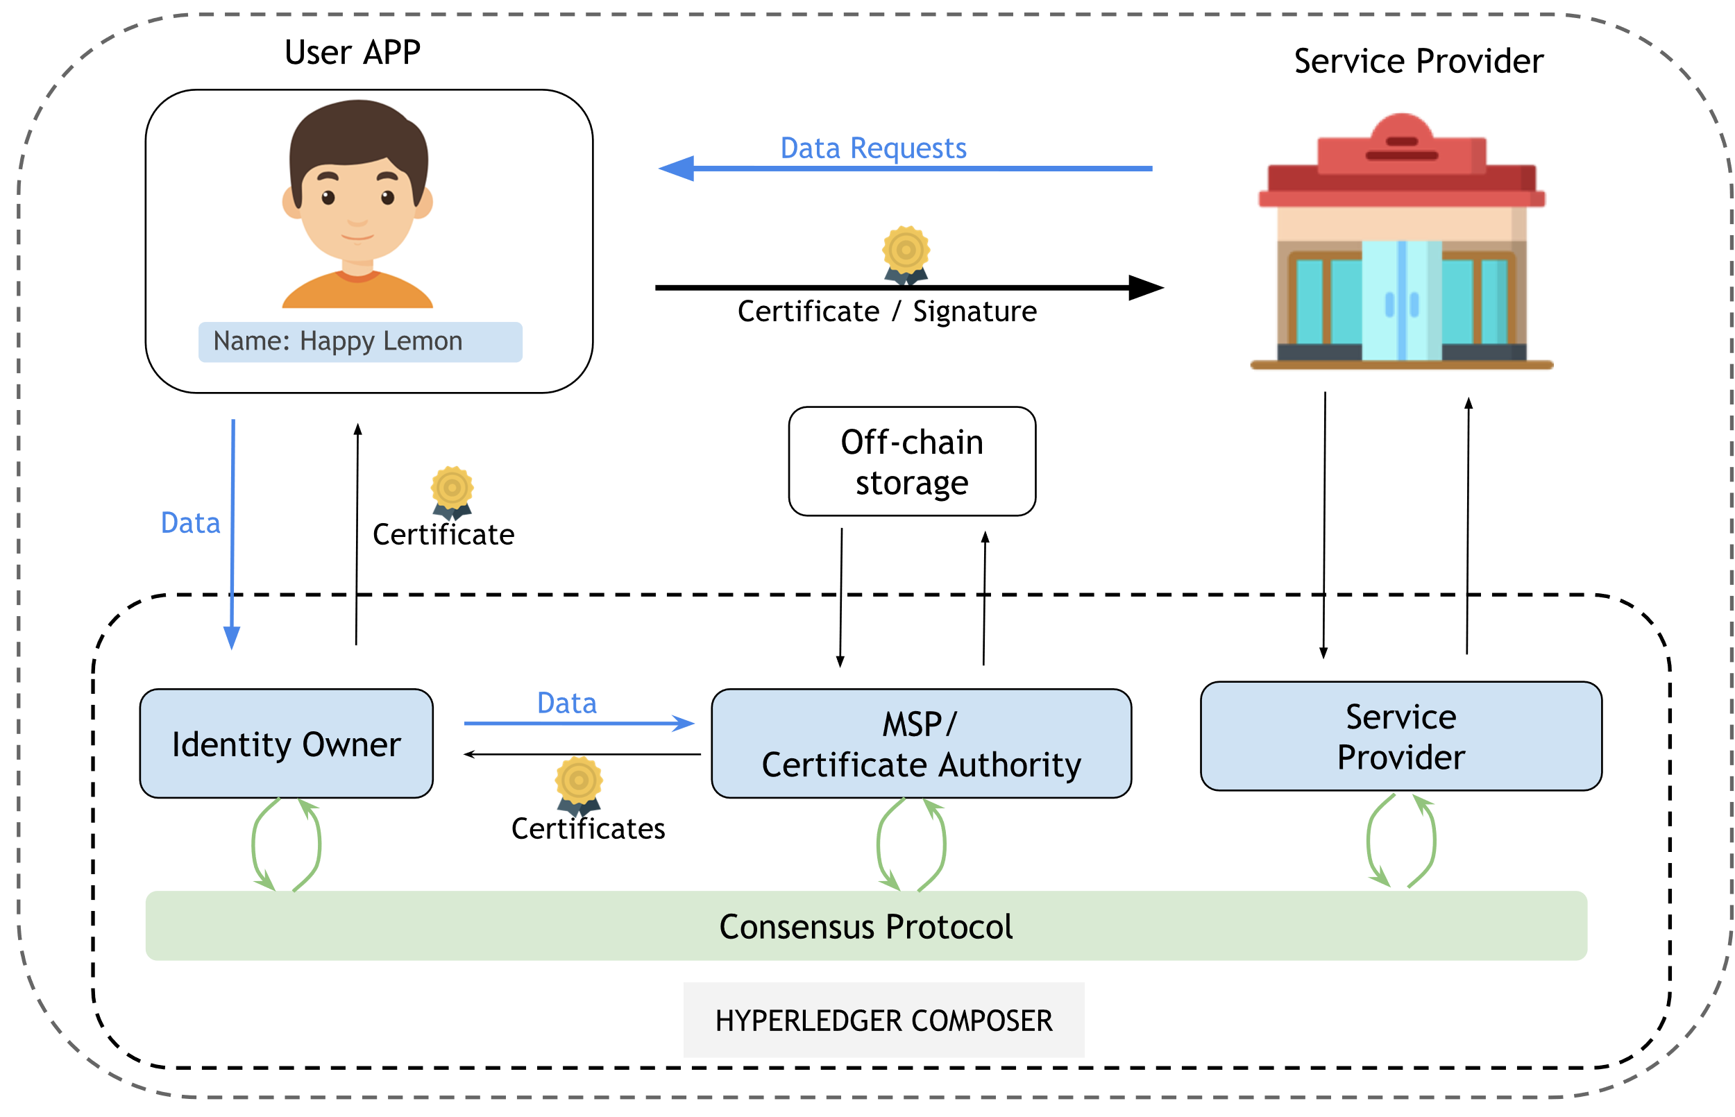
IDENTRIX Protocol

Slide 5
IDENTRIX
Demo
Notes:
QUESTIONS?

Slide 6
IDENTRIX
Questions?
Notes:
QUESTIONS?

Slide 7
IDENTRIX
Appendix
Notes:
QUESTIONS?

Slide 8



Authentication
1
Protect Primary Data
Authentication
2
Share Auxiliary Data
Information

Slide 9
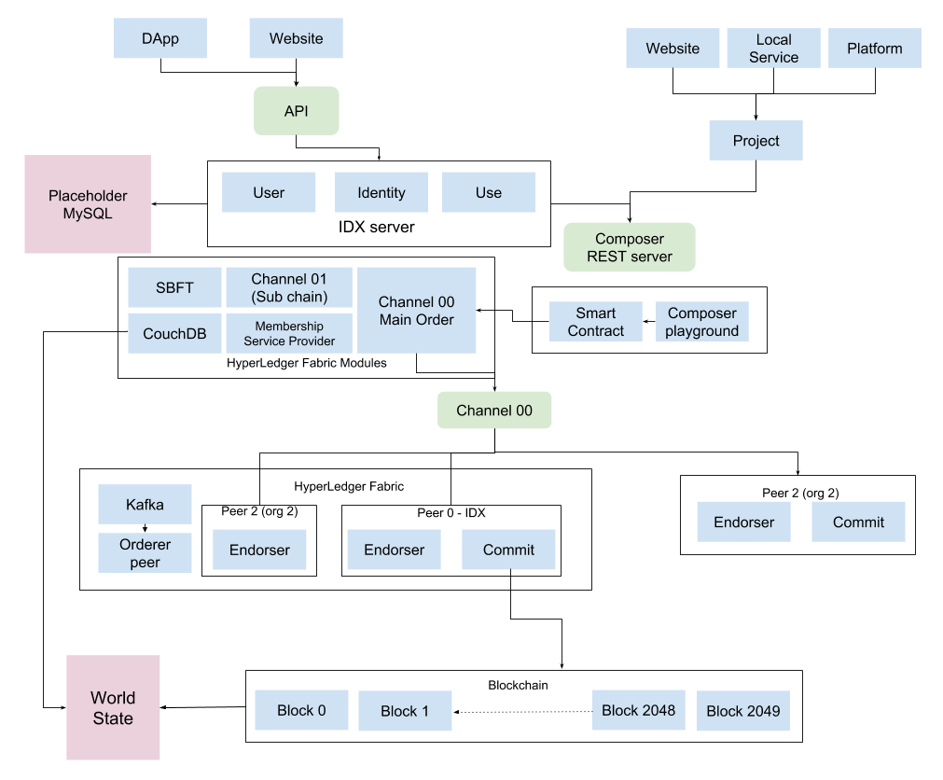

Slide 10
Rule of People
Rule of Algorithm
Blockchain technology represents a new realm of business, namely a distributed business model. In such space, all intermediaries can be replaced by mathematical algorithm
Feng Xiao

